Slide 2
Company Introduction
New Zealand inspired and founded natural milk company in Kolkata

Slide 3
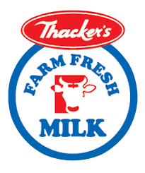
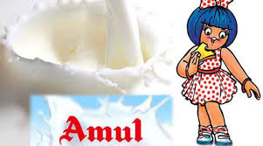
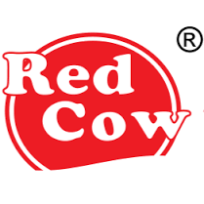
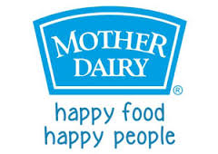
Milk Brands In Kolkata

Slide 4
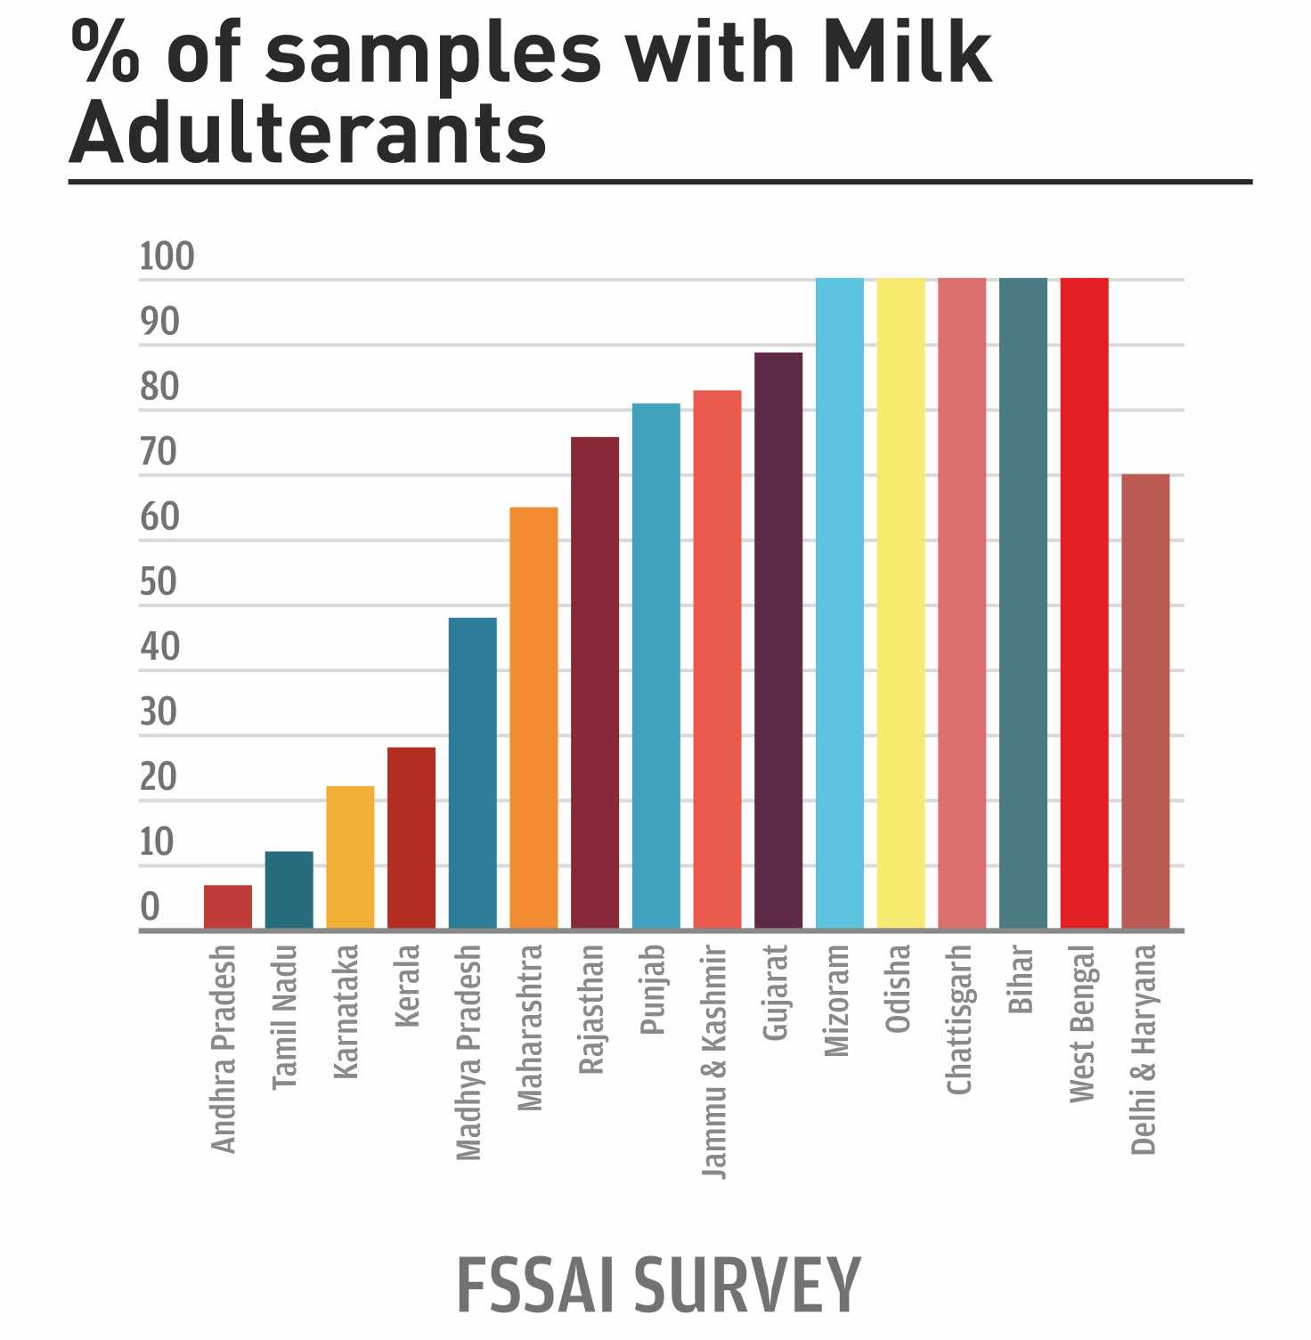
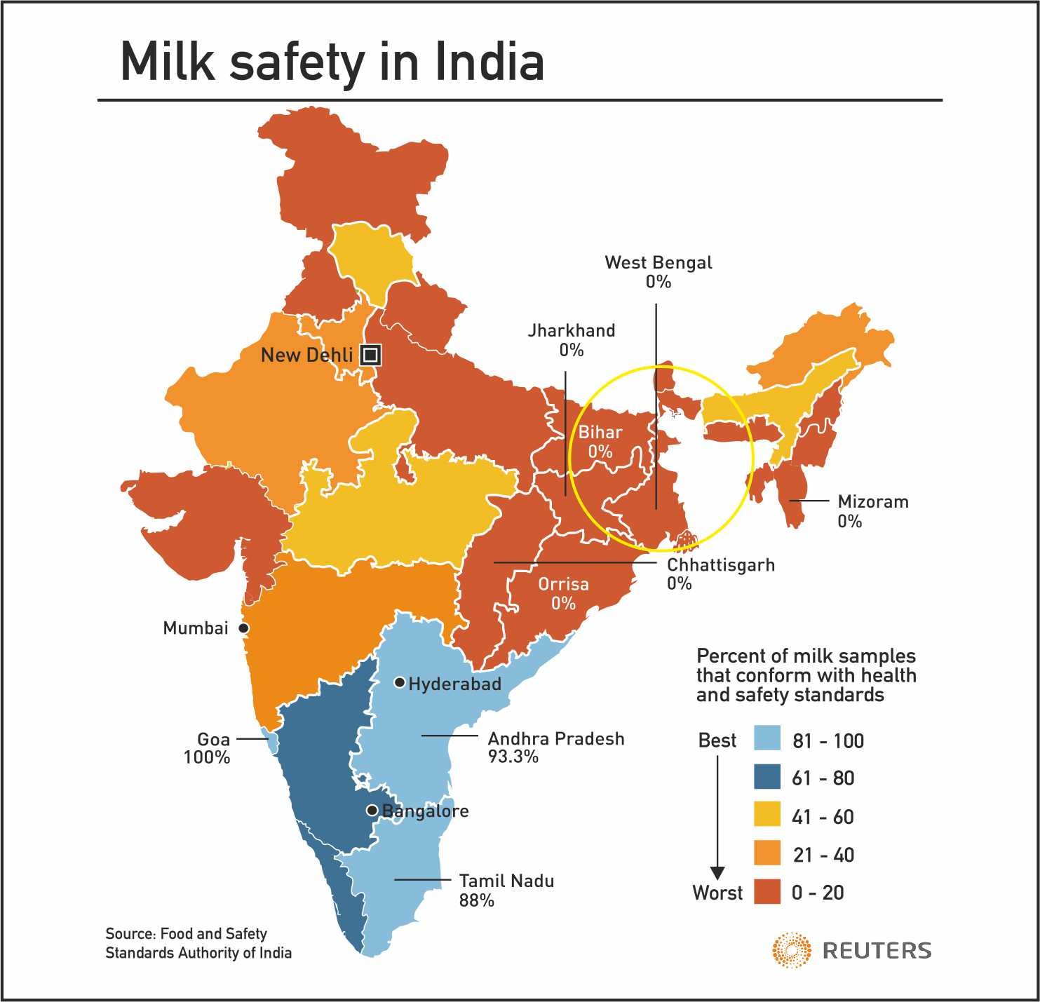
Bar Graph & Milk Safety Map

Slide 5
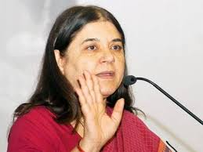
“Milk is unsafe for human consumption.”
- Maneka Gandhi (Firstpost: 28 Mar, 2016)
Minister of Women, Child development
Cows injected with oxytocin, illegal drugs
Sick cows overdosed with antibiotics
Filthy water with algae and fungi
Feed unfit for consumption
Milk having animal faeces, contaminants
Oxytocin mafia headquartered in Kolkata

Slide 6
Fatal adulterants in milk affecting lives
Milk that is available in the market comes laced with these three major adulterants, fatal over the long term:
Oxytocin
Antibiotics
Growth Hormones

Slide 7
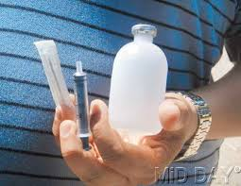
Oxytocin
It is an illegal drug which is being routinely used twice a day before milking
Early puberty
Hormonal Imbalance
Breast and Prostate cancer
Weight gain
Diabetes

Slide 8
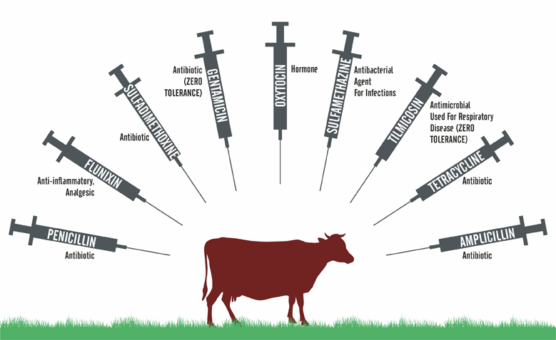
Antibiotics
It is the first line of defence
Cattle not insured so no appetite for risk
Cannot afford veterinarian surgeons
“Prani Bandhus” on bikes collecting cash giving excessive injections
Antibiotic Resistance

Slide 9
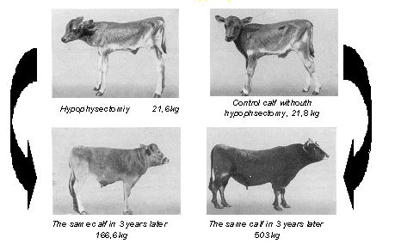
Growth Hormones
Calves producing milk before maturity
Increases milk production
Hormonal Imbalance in humans
Sterility and premature birth in human

Slide 10
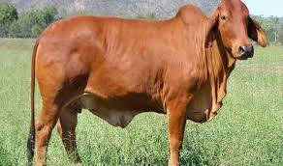
A2 Milk
Indigenous cows like Gir and Sahiwal cows produce milk with A2 protein. A2 milk has the following characteristics:
Closest to mother’s milk
Improves immunity
Fights against diseases and disorders.
BCM7 free
Gir Cow

Slide 11
Tremendous rise in heart diseases & diabetes?
Possible Contributors:
Hormones are a factor
Genetic mutation of cross- bred cows
A1 milk/Presence of BCM7

Slide 12
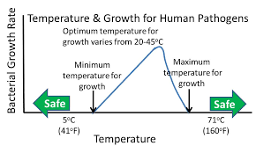
Benefits of pasteurization- Safety
Louis Pasteur
Safety
Transport
Logistics
Temperature & Bacteria

Slide 13
Case Study - Amul
Farmer collection model
Collects milk from milk collection centres
Milk contains oxytocin, hormones and antibiotics
Farmer maintains absolutely no hygiene
Focuses on quantity than quality.

Slide 14
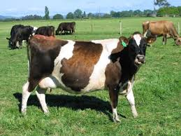
Case Study
Factory farms with industrial HF cows
Unnaturally high yielding exotic cows
Genetically modified for more milk
Cows yielding milk containing A1 proteins
Cows are regularly sick
Overdosed with antibiotics
Milk contains BCM7
- Causes heart diseases
- Autism in children
Holstein Friesian Cows

Slide 15
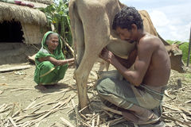
Farmer cooperative model of
milk collection
Starving farmers
No consequences
Such model no where else in the world
No loss to farmer since milk will always be sold
No veterinarian help
Excessive injections from self-proclaimed doctors
Sick cows milk in circulation

Slide 16
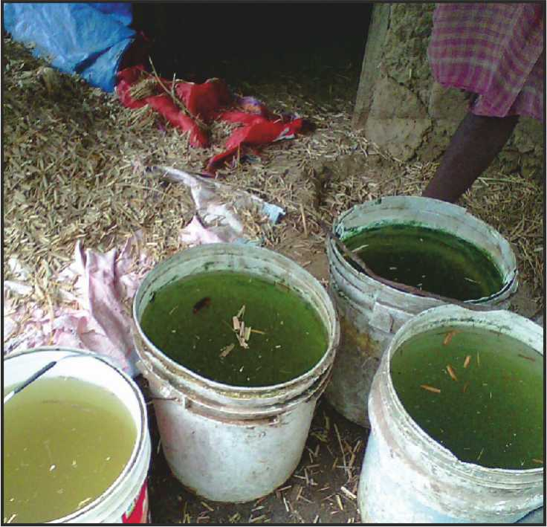
Water and Milk
There is high correlation with quality of milk.
Often pond water is source of water.
Filthy water is standard in farmer model.
Contaminants in pond water:
Algae
Cockroach
Fungi
Solid human waste

Slide 17
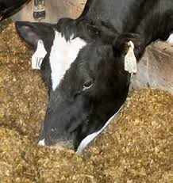
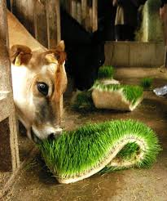
Green Fodder and Milk
Farmer’s cows are fed only on concentrates/ pellets
No green fodder in diet
Feed unfit for consumption
Milk from cows on green fodder has Beta Carotene
Concentrates “milk the cow”
Cows eating concentrates
Cows eating green fodder

Slide 18
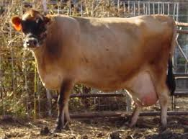
Cow Illness and Milk
Mastitis
Foot and Mouth Disease
No withdrawal period of milk from sick cows.
It’s not feasible to reject milk in any farmer collection model

Slide 19
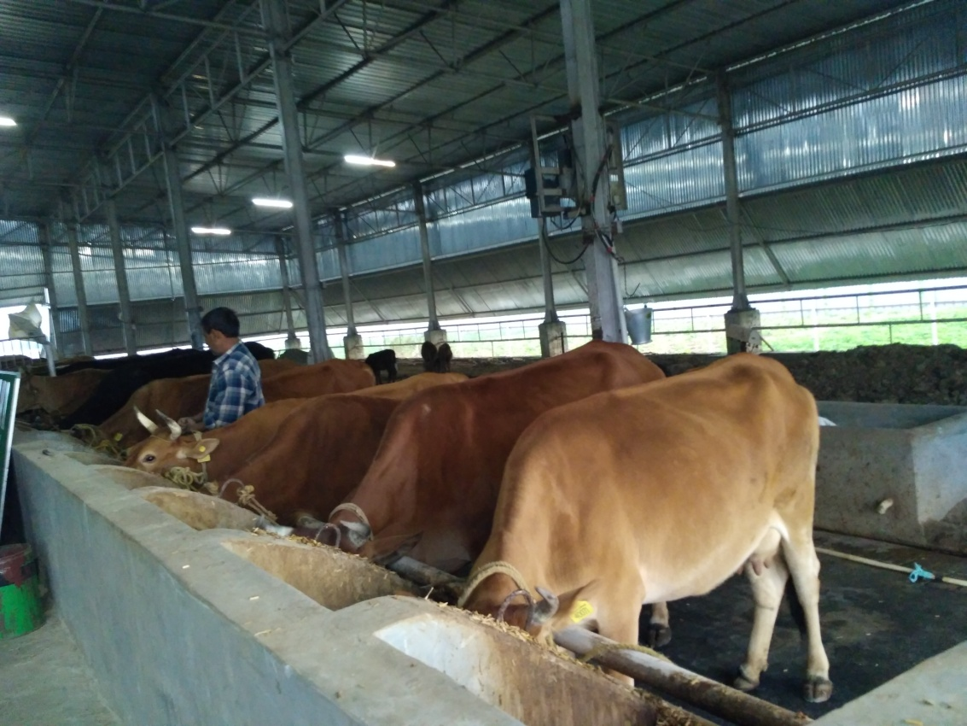
Puremilk
Oxytocin free
Antibiotic free
Growth Hormones free
Comprising A2 protein
Pasteurized

Slide 20
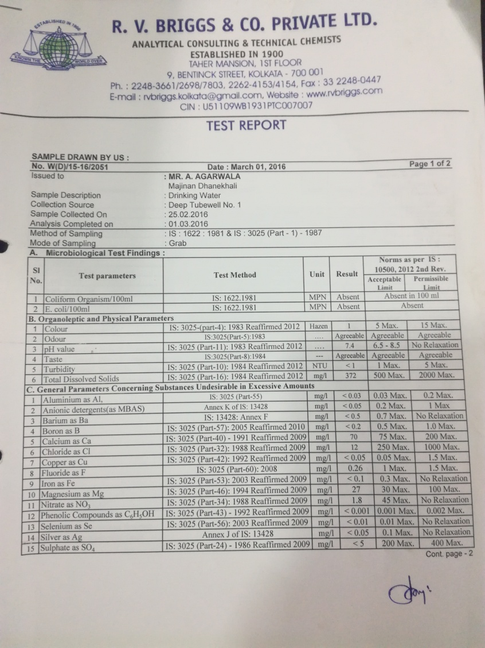
Water Management - Puremilk
Multiple heavy capacity deep bore-wells
Good water quality
FSSAI approval available

Slide 21
Feed for Cows

Slide 22
Our Veterinarian Team
Veterinarians delegated with the responsibility of taking care of cows:
Name Experience
Dr. Tapan Mukherjee (BCSC/AH) 42 Years
Mr. Sanjeet Ghosh (Livestock Development Assistant) 5 Years
Mr. Chinmoy Pan 7 Years
Mr. Mahadev Singh 5 Years
Mr. Paban Palra 2 Years

Slide 23
Inspiration for Puremilk
Pregnant women, young mothers, children and other milk drinkers depend on it for their daily nutrition
Increasing incidents of cardio-vascular problems, early puberty and cancer
No milk free from oxytocin, antibiotics and hormones

Slide 24
Mission statement
At our farms we do not compromise.
We do not ask how make milk cheaper.
We do not ask how to make lots of milk.
We only ask this:
How do we make milk better and better for women and children who shall consume it.

Slide 25
Questions?

